Slide 1
Complexity of conventional Sorting Algorithms
Course Code: CSC2211
Course Title: Algorithms
Dept. of Computer Science
Faculty of Science and Technology
Lecture No: | 4.2 | Week No: | 04 | Semester: | Summer 22-23
Lecturer: | Pritam Khan Boni; pritam.khan@aiub.edu

Slide 2
Lecture Outline
1. Sorting Algorithms
Counting Sort

Slide 3
Sorting Algorithms with linear time

Slide 4
Counting Sort
Counting sort: No comparisons between elements.
Input: A[1 . . n], where A[j] ∈ {1, 2, . . . , k}.
Output: B[1 . . n], sorted.
Auxiliary storage: C [1 . . k].
1 for i ← 1 to k
2
3 for j ← 1 to n
4
5 for i ← 2 to k
6
7 for j ← n downto 1 8
9
do C [i ] ← 0
do C [A[j]] ← C [A[j]] + 1
d C [i ] = |{key = i }|
d C [i ] = |{key ≤ i }|
do C [i ] ← C [i ] + C [i − 1]
do B[C [A[j]]] ← A[j]
C [A[j]] ← C [A[j]] − 1
12 / 26

Slide 5
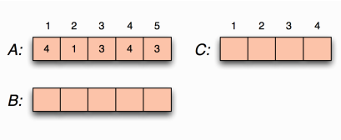
Counting sort example

Slide 6
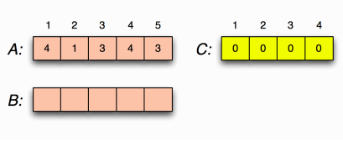
Counting sort example Loop 1
for i ←1 to k
do C [i ] ←0

Slide 7
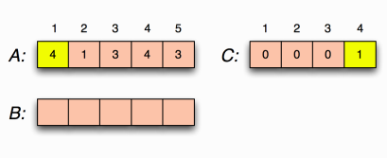
Counting sort example Loop 2
for j ←1 to n
do C [A[j ]] ←C [A[j ]] + 1
C [i ] = |{key = i}|

Slide 8
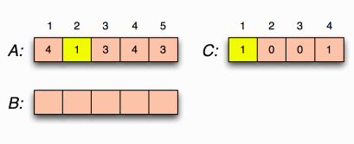
Counting sort example Loop 2
for j ←1 to n
do C [A[j ]] ←C [A[j ]] + 1
C [i ] = |{key = i}|

Slide 9
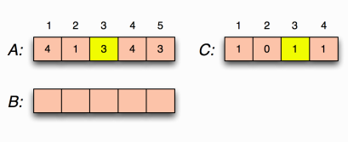
Counting sort example Loop 2
for j ←1 to n
do C [A[j ]] ←C [A[j ]] + 1
C [i ] = |{key = i}|

Slide 10
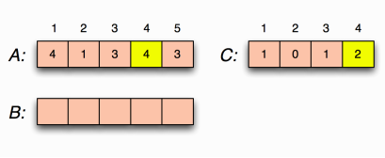
Counting sort example Loop 2
for j ←1 to n
do C [A[j ]] ←C [A[j ]] + 1
C [i ] = |{key = i}|

Slide 11
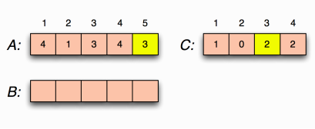
Counting sort example Loop 2
for j ←1 to n
do C [A[j ]] ←C [A[j ]] + 1
C [i ] = |{key = i}|

Slide 12
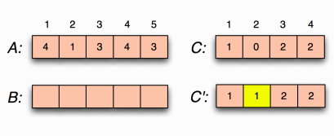
Counting sort example Loop 3
for i ←2 to k
do C [i ] ←C [i ] + C [i −1]
C [i ] = |{key ≤i}|

Slide 13
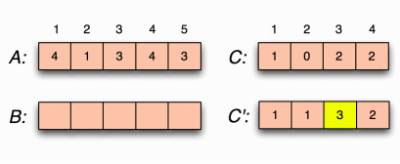
Counting sort example Loop 3
for i ←2 to k
do C [i ] ←C [i ] + C [i −1]
C [i ] = |{key ≤i}|

Slide 14
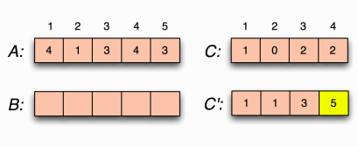
Counting sort example Loop 3
Consider as index of A
for i ←2 to k
do C [i ] ←C [i ] + C [i −1]
C [i ] = |{key ≤i}|

Slide 15
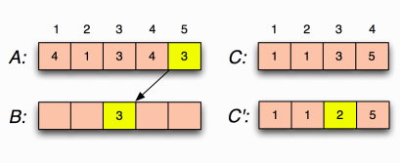
Counting sort example loop 4
Consider as index of A
for j ←n downto 1
do B[C [A[j ]]] ←A[j ]
C [A[j ]] ←C [A[j ]] −1

Slide 16
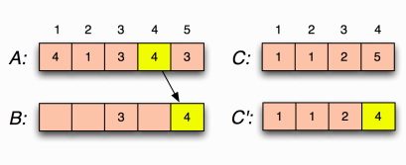
Counting sort example Loop 4
Consider as index of A
for j ←n downto 1
do B[C [A[j ]]] ←A[j ]
C [A[j ]] ←C [A[j ]] −1

Slide 17
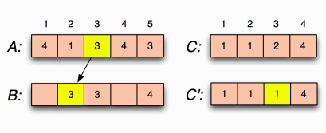
Counting sort example Loop 4
Consider as index of A
for j ←n downto 1
do B[C [A[j ]]] ←A[j ]
C [A[j ]] ←C [A[j ]] −1

Slide 18
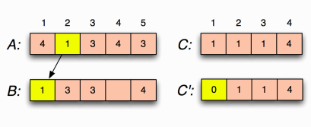
Counting sort example Loop 4
Consider as index of A
for j ←n downto 1
do B[C [A[j ]]] ←A[j ]
C [A[j ]] ←C [A[j ]] −1

Slide 19
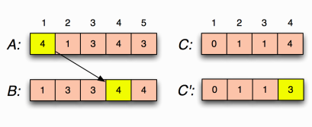
Counting sort example Loop 4
Consider as index of A
for j ←n downto 1
do B[C [A[j ]]] ←A[j ]
C [A[j ]] ←C [A[j ]] −1

Slide 20
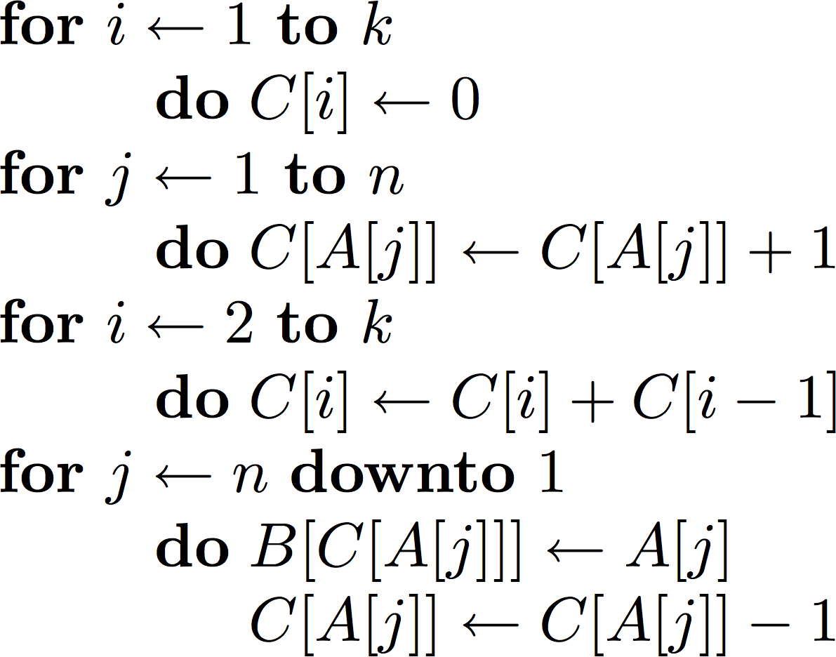
Counting sort Complexity
O(k)
O(n)
O(k)
O(n)
O(n + k)
The worst-case running time of Counting sort is O(n + k).
If k = O(n), then the worst case running time is O(n).

Slide 21
Books
Introduction to Algorithms, Thomas H. Cormen, Charle E. Leiserson,
Ronald L. Rivest, Clifford Stein (CLRS).
Fundamental of Computer Algorithms, Ellis Horowitz, Sartaj Sahni, Sanguthevar Rajasekaran (HSR)

Slide 22
Find out the recurrence relation of the algorithm and set a boundary using Master Theorem
funcA (ArrayA, leftIndex, rightIndex, increment){
if (leftIndex==rightIndex)
return;
for (i=leftIndex; i<rightIndex; i++)
ArrayA[i] = Array[i]+ increment;
mid = (rightIndex-leftIndex)/2;
funcA(ArrayA, leftIndex, mid, increment);
funcA(ArrayA,mid+1, rightIndex,increment);
funcA (ArrayA, leftIndex, mid, increment+1);
}

Slide 23
References
https://www.google.com/search?q=bubble+sort+
step+by+step&sxsrf=ALeKk01uxzgfT3Oy6k1Q3WxVnSpiIN8_4g:1587999728942
&tbm=isch&source=iu&ictx=1&fir=vRwFsGwVfJ6pJM%253A%252CSzhhze6MPQr4c
M%252C_&vet=1&usg=AI4_-kSrEEXqwRL-PkHhVUtn7jNfF9dB6g&sa=X&ved=2ahUK
Ewje0Pz974jpAhXRAnIKHWhMD2UQ_h0wAXoECAcQBg#imgrc=EN4Sdu7veOWVo
M&imgdii=eOqvCu85p9-eBM
https://www.interviewcake.com/concept/java/counting-sort
https://www.geeksforgeeks.org/counting-sort/
https://www.hackerearth.com/practice/algorithms/sorting/quick-sort/tutorial/

